Slide 1

Project II STOCK MANAGEMENT SYSTEM
BY: MILAN KARKI
Tu Register No: 6-2-712-52-2019
Roll No: 5

Slide 2
Project analysis slide 2
Introduction
Stock Management is the practice of ordering, storing, tracking, and controlling inventory Stock Management applies to every item a business uses to produce its products or services from raw materials to finished goods.
In other words, stock management covers every aspect of a business’s inventory.
Stock Management System helps in the efficient monitoring of constant flow of units into and out of an existing inventory. This process usually involves controlling the transfer in of units in order to prevent the inventory from becoming too high, or to low so that the operation of the company into difficulties.

Slide 3
Project analysis slide 2
Problem Statement
The main problem that occur in several company or retailer is a system to calculate the amount of stocks stored or needed.
Based on my survey, I have found that there are company that still using paper based or filing system to save their information or details about their stocks.
Heavily manual work will involve in managing and maintaining data which is time-consuming if the administrators or manager want to trace the product status, product information and etc.
This also may lead to a situation where the workers forgot to update the inventory manually or worst may lead to miscount when using manual system.

Slide 4
Project analysis slide 2
Objective
1. To design and develop a user friendly system which handles the information of items or products and calculated it to manage the information system.
2. To develop a system that deals with the day-to-day needs of organization like managing purchase, sales, return, and available stocks.
3. Keep each and every calculation and help to generate reports of transactions in Excel, PDF format.
4. Ease of printing the reports of every transaction like purchase, sales, and return

Slide 5
Project analysis slide 2
Scope and Limitation
SCOPE
LIMITATION
All authorized users with proper access credentials can use this system to manage Stock.
The system allows users to easily input, track, and update stock levels.
The system provides reports and analytics to help users make informed decisions about purchasing and inventory management.
The system can integrate with other business software, such as accounting or POS systems.
Keep each and every calculation and help to generate reports of transactions in Excel, PDF format.
Ease of printing the reports of every transaction like purchase, sales, and return,
The accuracy of inventory levels depends on the accuracy of data input by users.
The system may not be able to integrate with all other business software, depending on compatibility.
The system may require additional hardware or software to function properly, which can increase costs.
The system may have limited functionality for certain industries or types of businesses.
The system has limited amount of category.

Slide 6
Project analysis slide 2
Background Study
1.User Interface: The system should have a user-friendly interface that allows users to easily navigate through the system and perform various actions such as adding or editing stock items, generating reports, and managing inventory levels.
2.Dashboard: The system should have a dashboard that provides a quick overview of stock levels, sales trends, and other important metrics.
3.Stock Tracking: The system should be able to track stock levels for each item, including current stock levels, incoming stock, and outgoing stock..
4.Purchase Order Management: The system should allow users to create and manage purchase orders for stock items, including tracking the status of each order.
5.Sales Order Management: The system should allow users to create and manage sales orders for stock items, including tracking the status of each order.
6.Reporting: The system should provide a range of reports, including stock levels, sales trends, and inventory turnover, to help users make informed decisions.

Slide 7
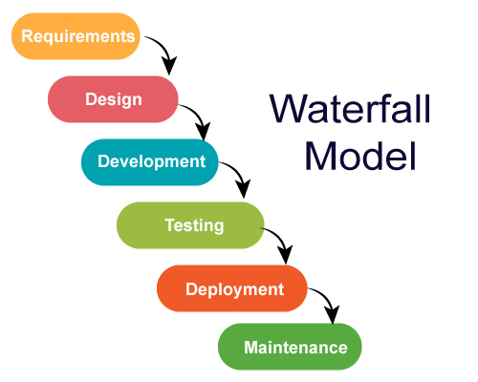
Project analysis slide 2
System Analysis
Waterfall methodology is used while building the website.
This project has specific documentation, fixed time, fixed requirements, well-understanding technology so in order to build this system waterfall methodology can be properly utilized.
Fig 1: Waterfall Model

Slide 8
Project analysis slide 2
Requirements
Functional requirement
User Module:
• User shall login the system.
• User shall Manage Purchase, Sales, and Return Orders.
• User shall printing Purchase, Sales, Return Orders and Exporting data into excel or PDF.
• User shall View Back Order.
• User shall view available Stocks.
Admin Module:
• Admin shall login the system.
• Admin shall Manage Purchase, Sales, and Return Orders.
• Admin shall see the registered users and create the user.
• Admin shall delete the user.
• Admin shall view available Stocks.
• Admin shall printing Purchase, Sales, Return Orders and Exporting data into excel or PDF
• Admin shall printing Purchase, Sales, Return Orders and Exporting data into excel or PDF.
• Admin shall manage supplier.
• Admin shall manage Item list.

Slide 9
Project analysis slide 2
Requirements
Non-Functional Requirement
Performance: The system should be designed to handle large amounts of data and transactions with minimal response time. It should be able to process multiple user requests simultaneously without affecting system performance.
Reliability: The system should be reliable and available at all times. It should be able to recover from any failures or crashes without losing data or disrupting business operations.
Security: The system should be secure and protect sensitive inventory and customer data. It should be designed to prevent unauthorized access, data breaches, and other security threats.
Usability: The system should be user-friendly and easy to use, with a well-designed user interface and clear navigation. It should be able to support multiple languages and be accessible to users with disabilities.
Scalability: The system should be able to scale to handle increased data volumes, users, and transactions as the business grows. It should be designed to handle future expansion without significant system redesign.

Slide 10
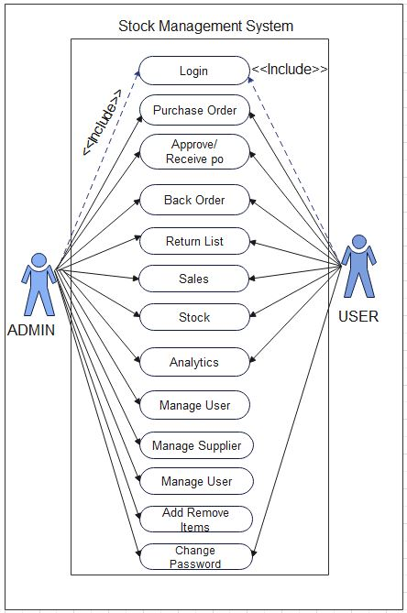
Project analysis slide 4
Use Case Diagram
Fig 2: Use Case Diagram

Slide 11
Project analysis slide 2
Requirements
Feasibility study
Technical feasibility: In order to design this system, it uses existing technologies, software and hardware so there is no technological hurdle to build this system.
Economic feasibility: The system development does not have any requirement of expensive hardware and software, and used software are mostly open source so development is economically feasible.
Operational feasibility: The proposed system is operationally feasible as it is reliable for all type of user i.e., whether or not the user has the knowledge of computer or not. It is simple and easy to use due to simple user interface and its operational feasible.
Schedule Feasibility: The system that we developed is scheduling feasible as it does not require more time for the development phase.

Slide 12
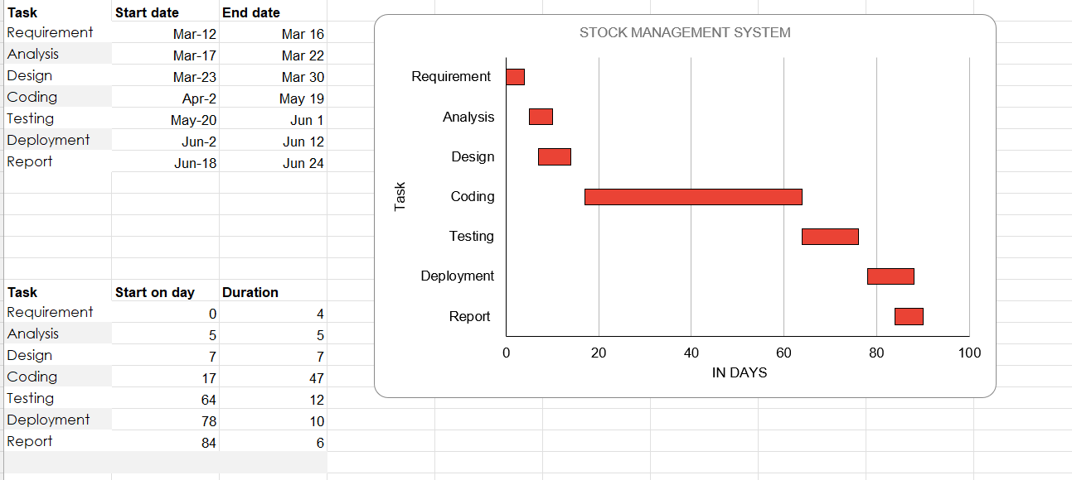
Project analysis slide 2
Requirements
Gantt chart is used for planning projects of all sizes, and it is a useful way of showing what work is scheduled to be done on a specific day.
It can also help you view the start and end dates of a project in one simple chart.
.
Fig 3: Gantt Chart

Slide 13
Project analysis slide 2
Requirements
Tools and Technology Used:
The Following software is used for the development of the System.
VS Code
MySQL
Apache [Xampp]
Minimum Windows 8 required.
.

Slide 14
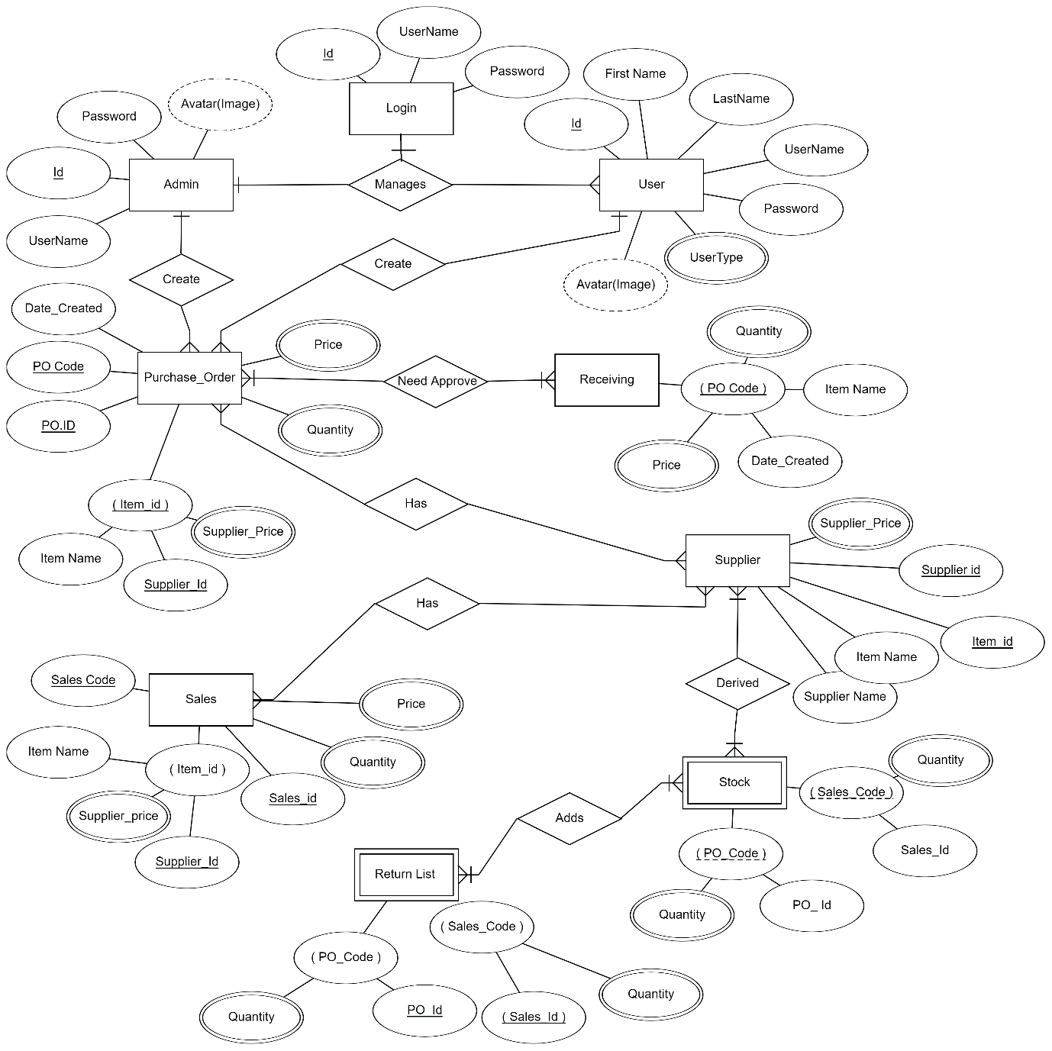
Project analysis slide 4
Entity Relationship Diagram
Fig 4: Entity Relationship Diagram

Slide 15
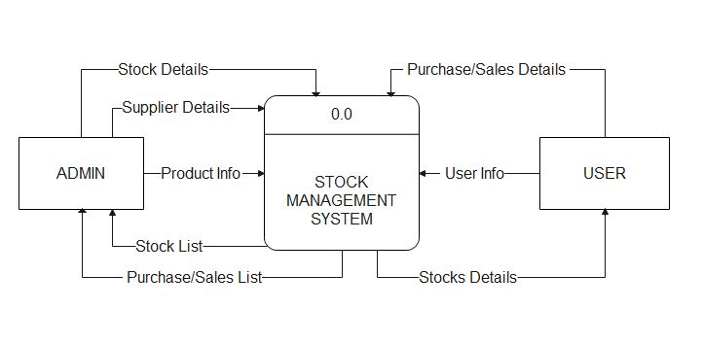
Project analysis slide 4
Process Modelling (DFD)
Fig 5.1: DFD Diagram (Level 0 DFD)

Slide 16
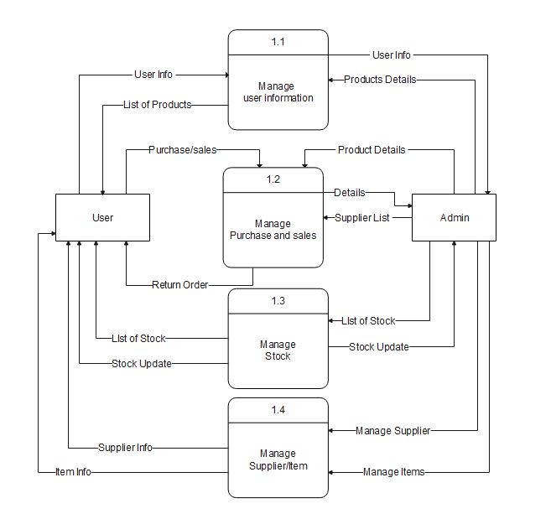
Project analysis slide 4
Process Modelling (DFD)
Fig 5.2: DFD Diagram (Level 1 DFD)

Slide 17
Project analysis slide 4
Possible Outcome
When this project is completed, we developed Stock Management System with Proper Functionality, Validation and verification.
In this System the Admin and Users will be able to login in the system, Create Purchase Order, Approve Orders, If the Orders are Partially approved then the not Approved order will be Displayed in Backorder, and will also be able to Create Return List then list will be added to the remaining stocks, and the Admin and Users will also be able to create Sales list and will be able to See the Remaining Stocks.
The System will also generate the bill in printable format, PDF format and Excel format. Admin will only have the privileges to create and add Suppliers and Items in the system. The User and Admin will Both Be able to see the Analytics Part in the system. The analytics part will cover the Sales analytics, Purchase analytics, Top seller, Stocks Quantity analytics, and Quantity Flow in the system.

Slide 18
Project analysis slide 4
Reference
[1]techtarget.com,“techtarget.com,”.[Online].Available:https://www.techtarget.com/searchcio/definition/stock. [Accessed 1 5 2023].
[2] erdplus.com, ”erdplus.com”, [Online].Available:https://erdplus.com/standalone. [Accessed 5 5 2023].
[3]researchgate.net.”researchgate.net”,[Online].Available:https://www.researchgate.net/publication.[Accessed 3 5 2023].
[4] Ramesh singh saudh , System Analysis and Design, Ktm: KEC Publication, 2020(Revised).
[5] Ramesh singh saudh , Software Engineering, Ktm: KEC Publication, 2020(Revised).
[6] Alexandre de Castro Moura and Alessandra Angelucci, "A System for Stock Management of Clothing Retail Companies," Procedia Manufacturing, vol. 39, pp. 545-554, 2019.
[7] G. H. Hashmi, M. H. Jamil, and A. I. Sheikh, "Development of an Automated Inventory Management System using RFID," International Journal of Advanced Computer Science and Applications, vol. 8, no. 5, pp. 322-327, 2017.
[8] Imran Khan, "Development of an Inventory Management System for Small Business," International Journal of Computer Applications, vol. 180, no. 36, pp. 34-40, 2018.
[9] Alexandre de Castro Moura and Alessandra Angelucci, "An Analysis of the Use of Barcodes and RFID in Stock Management of a Clothing Retail Company," Journal of the Brazilian Society of Mechanical Sciences and Engineering, vol. 41, no. 11, pp. 1-12, 2019.
[10] J. A. N. Martins and J. M. F. Calado, "A Framework for Stock Management in Small and Medium-sized Enterprises," International Journal of Production Economics, vol. 132, no. 2, pp. 294-305, 2011.

Slide 19

Project analysis slide 4
Any Question?

Slide 20
Thank You

